Slide 1
Project Unicorn Weekly Update Meeting 0911
Present: Paul Li

Slide 2
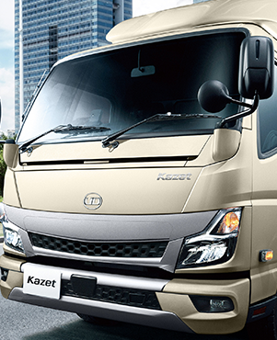
Outline
Taikoo Motors Organization
Project Scope
Market Overview
Competitors Comparison
Summary & Next Step

Slide 3
Taikoo Motors Organization
Willy Chen
Executive Director
Tony Ng
Aftersales Manager
Kinson Tang
Sales Manager
Laurent Tse
Commercial Manager
Roy Lam
Product Manager
Dick Chan
Sales Operation Manager
Reinhard Wang
Assistant General Manager- Aftersales
Vincent Sun
Product Manager
Phyona Wang
Assistant General Manager- Truck Operation
Bonnie Chen
Assistant General Manager- Bus Operation & Marketing
Page Chang
Logistic & Sales Support Manager
HK Team
TW Team

Slide 4


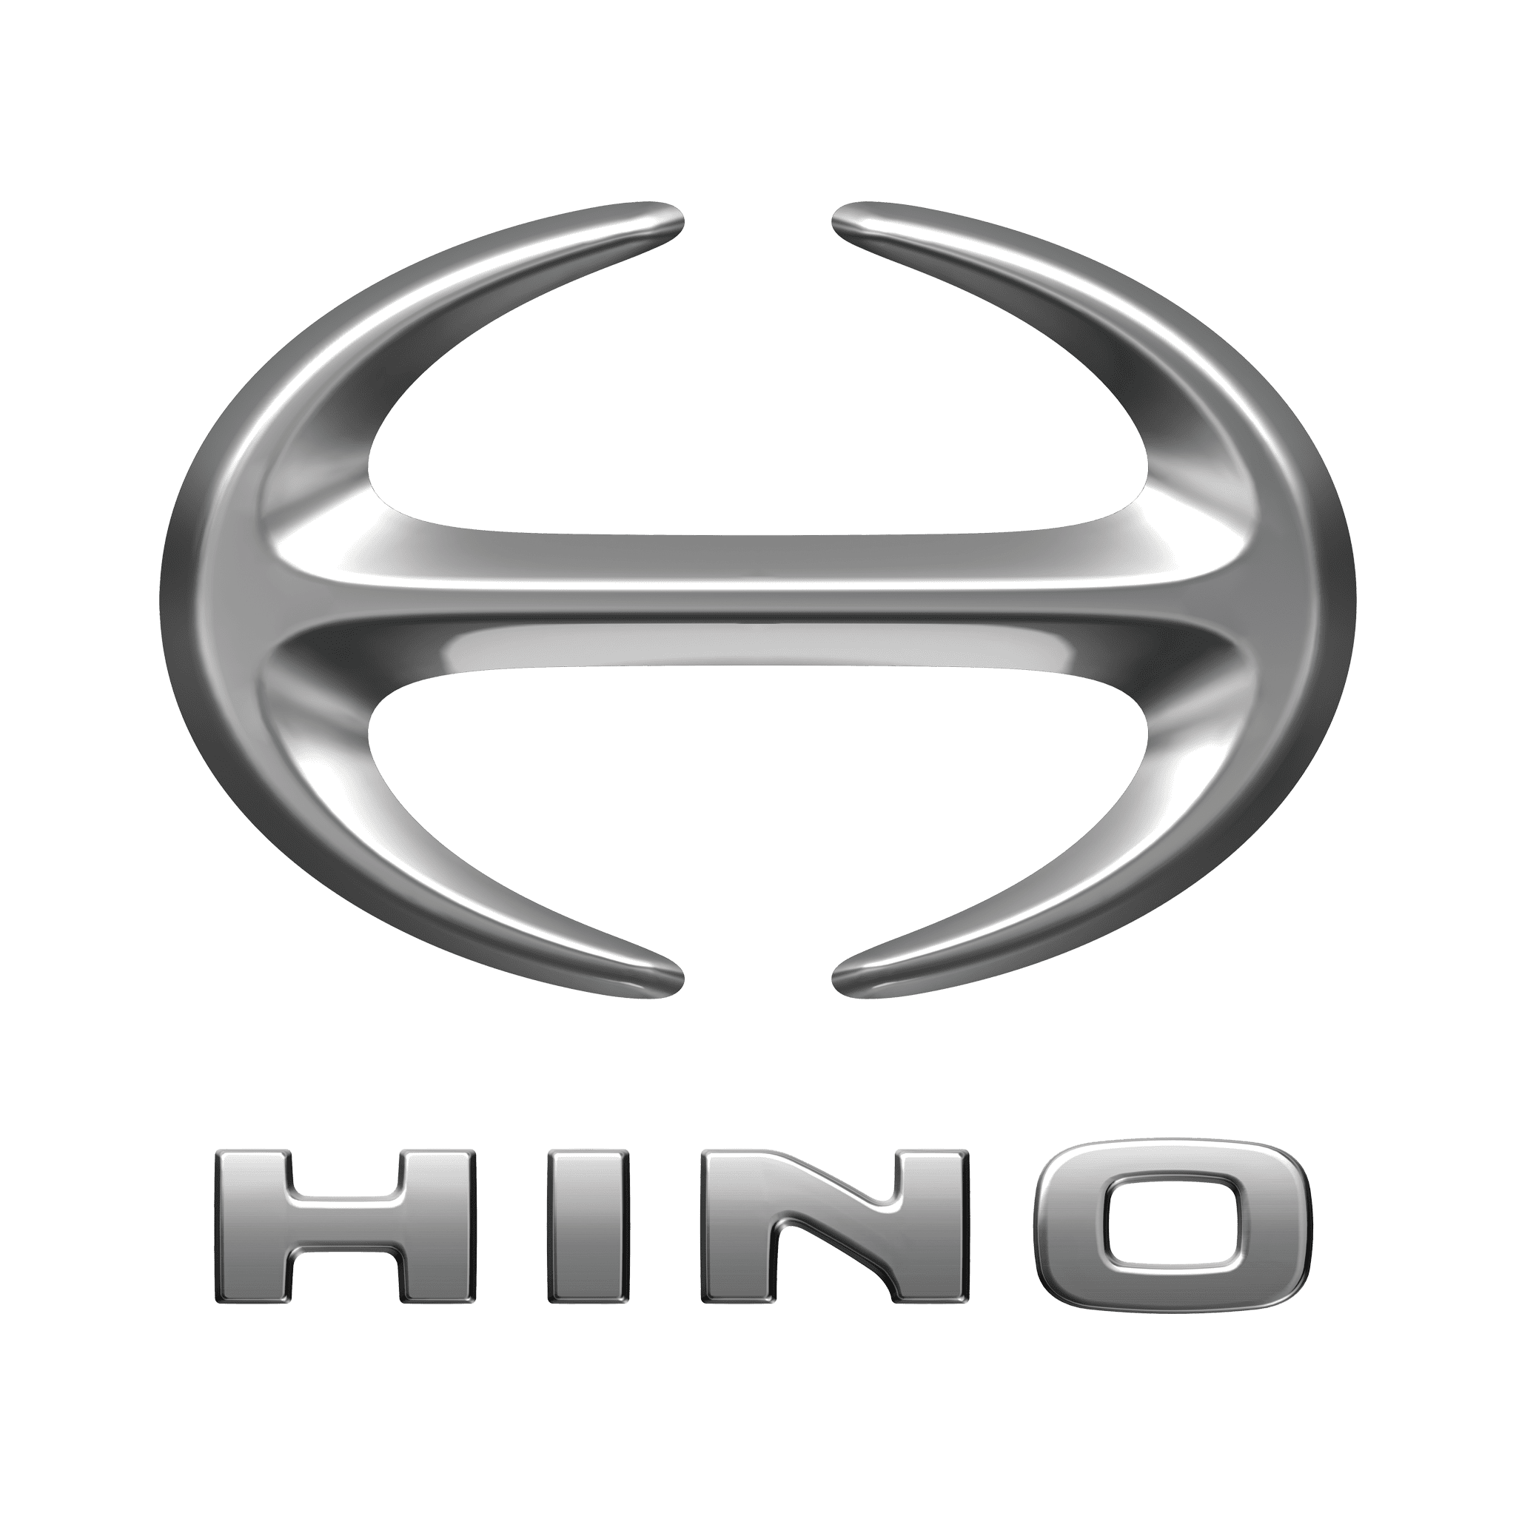

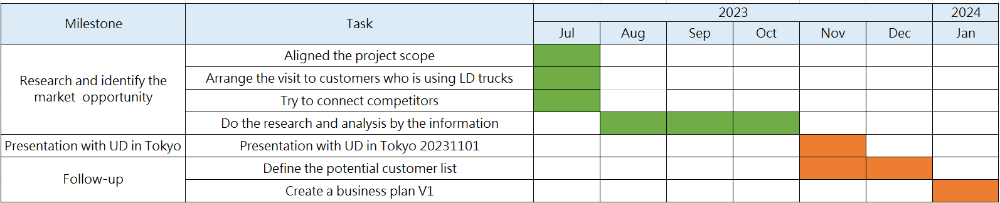
Project Scope
Background and Market Potential
Product Definition & Competitors
Project Unicorn, aims to introduce UD EUR6 light (10.4-14T)to medium-duty(15-18.5T) trucks into the markets of Hong Kong and Taiwan.
LD Truck =>GVW 10.4-14T
MD Truck =>GVW 15-18.5T
Project Schedule
Market Potential
Potential Risk
Creating a complete product lineup with sales in different segments
Increasing customer retention
Stimulating sales of medium and heavy-duty trucks
Using the same chassis as ISUZU, but with a higher pricing strategy
There is no clear direction for electric vehicles (EVs)

Slide 5
Market Overview

Slide 6
HINO, FUSO and ISUZU are main competitors in LD trucks market
Filter Criteria
GVW: 10.4T -14T
Total Market
By Brands
Summary
Market Leader: HINO→ ISUZU→FUSO →DAF (Leaders are all JP brand)
Main permitted GVW: 11T (6176 Units/2018-202308)(1100Units/year)
Competitive Products: HINO(300 Series)→ ISUZU(N Series)→FUSO(CANTER/ FE)
Total new registration 2021-202305 => 6459 (About 2500 units/year)

Slide 7
HINO is the leader of MD trucks market and FUSO is beating ISUZU
Filter Criteria
GVW: 15T-18.5T
Total Market
By Brands
成果效Summary益
Market Leader: HINO→ FUSO →ISUZU →DAF
Main permitted GVW: 17T (6878 Units 1000Units/year)/18.5T (2764 Units 500Units/year) => Both lead by HINO
Competitive Products: HINO(500Series)→ ISUZU(FRR/FVR)→FUSO(FK_FM)

Slide 8
CBU OR CKD ISUZU
Total Market
成果效Summary益
Division:
11T and above: Mostly CKD (Medium-duty trucks)
Below 11T: Mostly CBU (Light-duty trucks)
CKD: FVR (17/18.5T)/ FRR (11T)
CBU: NMR (6T)/ NPR (7T)/ NQR (9.5T)/ FVR (15T)
 | CBU | CKD
5T-9.5T | 81% | 19%
11T-18.5T | 16% | 84%

Slide 9
CBU OR CKD FUSO
Total Market
成果效Summary益
Division:
11T and above: Mostly CKD (Medium-duty trucks)
Below 11T: Mostly CBU (Light-duty trucks)
CKD: FKL (11T)/FM(17T)
 | CBU | CKD
6 - 10.4T | 68% | 7%
11 - 18.5 | 32% | 93%

Slide 10
HK LD Market Data
Filter Criteria
LGV + MGV
Body Type: Remove Pick-up, Van
Total Market
By Brands
2015 | 2016 | 2017 | 2018 | 2019 | 2020 | 2021 | 2022 | 2023
4026 | 3052 | 3171 | 2874 | 2602 | 1362 | 1721 | 1880 | 803
Summary
ISUZU is the main leader of the market ->HINO -> FUSO
About 2500 Units/year (Average of 2015-2022)
Recovery trend after COVID

Slide 11
HK MD Market Data
Filter Criteria
MGV
Body Type: Remove Tractor => Avoid too high cylinder capacity(over 10000CC)
Total Market
By Brands
成果效Summary益
HINO and ISUZU are main competitors in the market
About 865 Units/year(Average of 2015-2022), most are for special usage
Negative trend after COVID
EUR Brands share this market

Slide 12
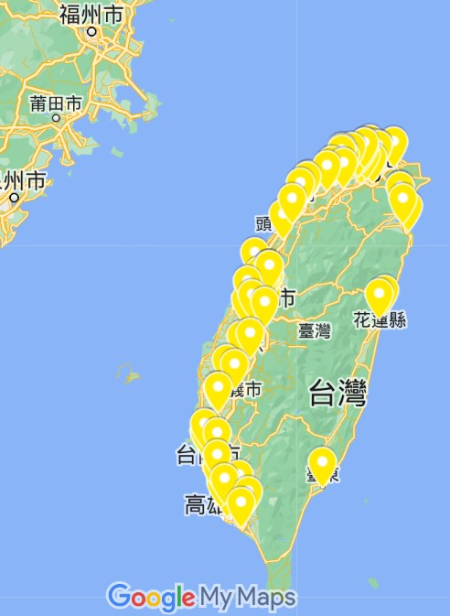
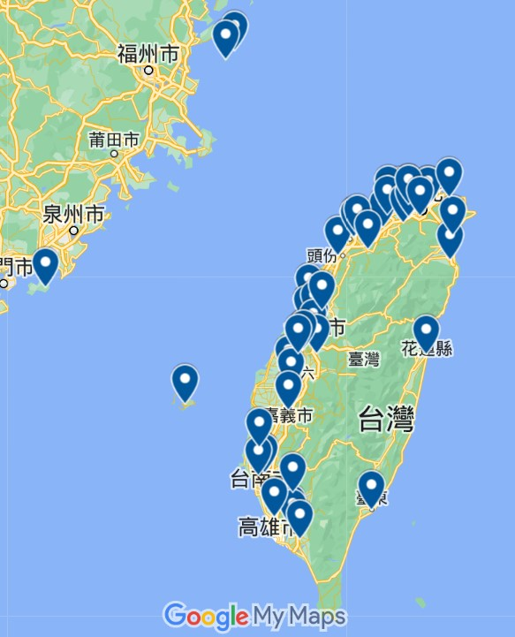
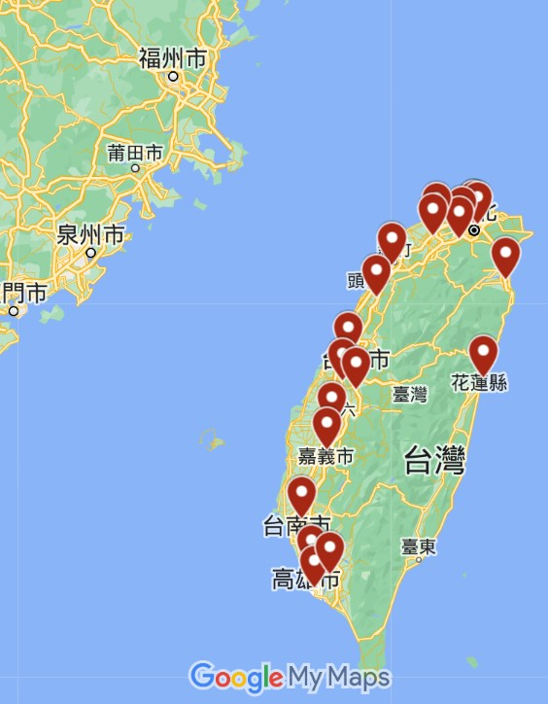

HINO leads the market with the lowest service centers.
FUSO TW
IZUSU TW
HINO TW
Total Quantity:79 (S:33/AS:78)
Total Quantity:46 (D:12/C:34)
Including Islands District
Total Quantity:21 (D:21)
All centers provide both sales and aftersales

Slide 13
Quality wins the quantity
IZUSU TW
IZUSU is the only brand that collaborates with other foreign manufacturers
Occupy the island district market
Some location only for sales operation
HINO TW
Conclusion:
Quantity is not the key to the market
Every county needs at least one point
HINO leads the market with the lowest service centers.
Need more information for the difference of the service
All service centers belong to HOTAI Motors.
FUSO TW
FUSO has three times as many service centers as HINO, but still lags behind in terms of sales.
All centers are belong to 裕益 group

Slide 14
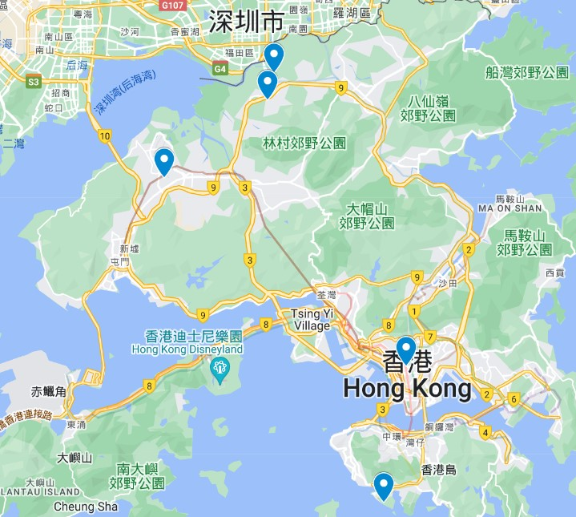
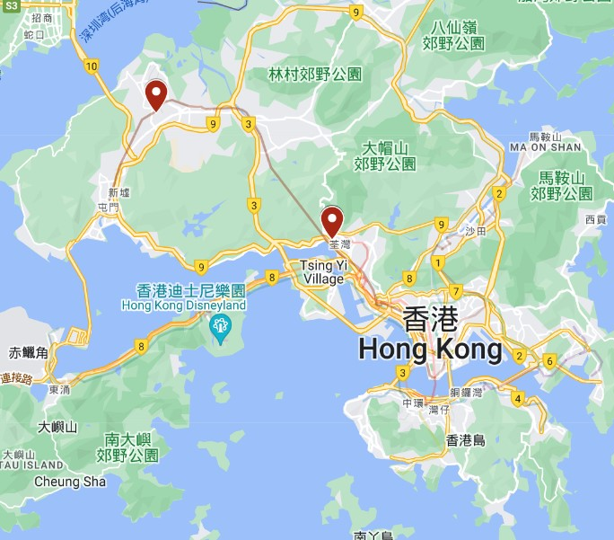
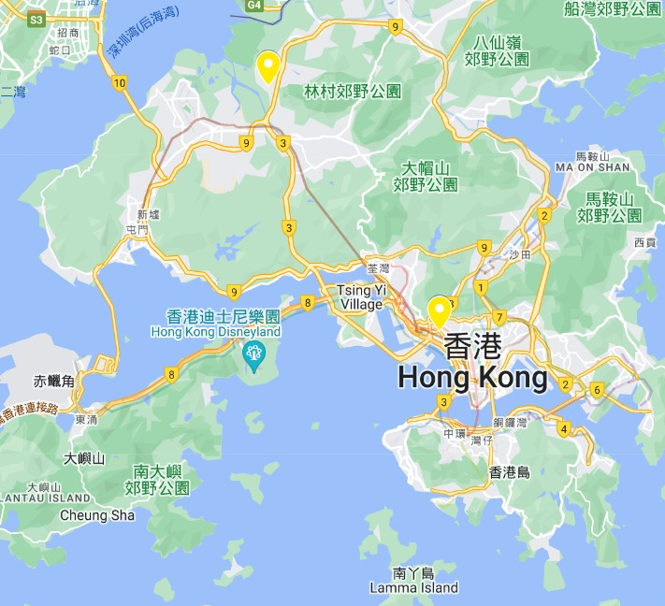
Service Center Location HK
IZUSU HK
HINO HK
FUSO HK
Total Quantity:5(S:2/A:3)
Locations include HK island, Kowloon, and New Territories
Total Quantity: 2
Total Quantity:2 (S:1/A:2)
Serve Macau

Slide 15
About Marketing
HK Market
HINO is the only brand focusing on marketing
Keep updating FB
Brand Advocate: 林雪/鄺芷凡
ISUZU has both YT and FB, but rarely update
FUSO has no SMS
TW Market
IZUSU mainly shares the knowledge about trucks.
HINO cooperates with celebrities and share different contents
Comics about drivers
Story about drivers
FUSO cooperates with YTRs to reach more audience
In the Taiwan market, there is a greater emphasis on marketing
HINO utilizes celebrities in both Taiwan and Hong Kong to attract a larger audience
IZUSU dominates HK market without doing frequent marketing

Slide 16
Customer visits: Aftersales is the key
Safety
Summary
Specific regulation for the certain circumstance might be our opportunity
Except for price, there are more factors can help customers save the cost
The quality of aftersales service might the priority for Project Unicorn
Shorter maintenance time and longer maintenance intervals
Quality > Quantity
In addition to the basic safety tests, due to its unique requirements, customers might request to have some specific measures in place.
Cost
Total Cost = Vehicle Price + Fuel + Maintenance + Tax
Low displacement but high horsepower
Aftersales
Volvo aftersales service has great reputation in the market
For light trucks, the key is to ensure that the maintenance capacity keeps up. At least one in several important major cities.
Although HINO has the fewest service points, its maintenance staff receives excellent training and benefits. As a result, they can provide stable after-sales service to increase customer loyalty.

Slide 17
Competitors Comparison

Slide 18
LD Truck Sales Data Long wheelbase product and 8-9T is the most popular
Data Cleaning
Based on the new registration data from 2021 to 2023
Without distinguishing between AT/MT
Comparison
No. | GVW | Brand | Model | Qty | Analysis
1 | 8-9T | HINO | XZU720L-WCFSWR3 | 986 | Intermediate displacement within its class, lower tax than ISUZU by one level. Similar performance, spacious cabin.
2 | 6T | IZUSU | HMJ6/HAJ6 | 672 | Low displacement but high horsepower, weaker torque, inferred from gear ratio, suitable for urban or highway use. Mainly used for logistics.
3 | 7T | IZUSU | NPR75 KM6/KA6 | 460 | The highest displacement in its class, offering the best performance. Offer 7 seats
4 | 7T | HINO | XZU640L- WCMRVR3 | 403 | Shortest wheelbase, optional high roof.
5 | 6T | FUSO | FKEE | 374 | The lowest displacement in its class, poorest performance, likely valued for its price.
6 | 8-9T | FUSO | FKJG | 358 | Same as No.5
7 | 8-9T | HINO | XZU710L- WCFSWR3 | 322 | Same as No.1
8 | 8-9T | FUSO | FKJE | 289 | Same as No.5
9 | 8-9T | IZUSU | KMJ6/KAJ6 | 255 | The highest displacement in its class, offering the best performance
10 | 8-9T | IZUSU | LMJ6/LAJ6 | 254 | The highest displacement in its class, offering the best performance
Summary
Opinion from HINO
6/7-8/9 are two main segment in LD market.
Long wheelbase, low displacement is more popular.
HINO -> ISUZU -> FUSO
Customers in LD market are highly cost sensitive
Pursuit longer maintenance interval and shorter duration with convenience
Expect to build 5 new facilities(21->26)
It takes 5 years to release a new product

Slide 19
MD Truck Sales Data 11/18T are the main market, HINO dominate the market
Data Cleaning
Based on the new registration data from 2021 to 2023
Without distinguishing between AT/MT
Comparison
No | GVW | Brand | Model | Qty | Analysis
1 | 17 | HINO | T8A-UGF(With ACC) | 915 | The second-longest wheelbase in its class, comes with standard ACC, and has intermediate displacement with the best performance.
2 | 11 | HINO | L7A-DBCPF | 677 | It combines a higher displacement engine (6403) for improved torque while maintaining the same horsepower as ISUZU.
3 | 17 | HINO | R8A-UGF(With ACC) | 555 | Same as No.1 but with a shorter wheelbase.
4 | 17 | HINO | M8A-UGF(With ACC) | 296 | Same as No.1 but with a shorter wheelbase.
5 | 18 | FUSO | FKSN9/FKSN1 | 287 | Intermediate wheelbase, and the worst performance in its class, likely with a price advantage.
6 | 11 | HINO | P7A-DBCPF | 283 | Same as No.2 but with the longest wheelbase.
7 | 18 | FUSO | FKSL9 | 268 | Intermediate wheelbase, likely with a price advantage.
8 | 11 | FUSO | FKLK1/FK62FKY5 | 257 | Shorter wheelbase, with the worst performance in its class, likely with a price advantage, and an option for imported models.
9 | 11 | IZUSU | NMC6/NAC6 | 238 | Long wheelbase, with the option for a larger displacement engine.
10 | 11 | HINO | J7A-DBCPF | 237 | Same as No.2 but with a shorter wheelbase.
Summary
HINO > FUSO > ISUZU => Only HINO provides standard ACC and it seems to be an attractive factor
Although FUSO provides imported models, specification is all the same. 18T is the most popular, but without imported option.
Many serve special purposes, such as street sweepers, fire trucks, garbage trucks, and so on.
The ratio of different brands and sizes of trucks (with 10T as the dividing point) is as follows: HINO 6/4 | ISUZU 4/6 | FUSO 6/4

Slide 20
Business Plan

Slide 21
LD(11T) Business Plan (TW)
Assumption
Inflation Rate | 2%
Average unit selling price (NTD) | 2,700,000
Average maintenance price (NTD) | 80,000
Gross profit margin (%) for Sales | 0.06
Gross profit margin (%) for Aftersales | 0.35
CAGR of total market | 1.61%
Target | 3rd in the market
 | 2025 | 2026 | 2027 | 2028 | 2029 | 2030 | 2031 | 2032 | 2033 | 2034 | Total
Vehicle sales
Unit of car sold by TMG (#) | 50 | 100 | 200 | 300 | 300 | 300 | 300 | 300 | 300 | 300
Average unit selling price (NTD) | 2,700,000 | 2,754,000 | 2,809,080 | 2,865,262 | 2,922,567 | 2,981,018 | 3,040,639 | 3,101,451 | 3,163,480 | 3,226,750
Revenue (NTD) | 135,000,000 | 275,400,000 | 561,816,000 | 859,578,480 | 876,770,050 | 894,305,451 | 912,191,560 | 930,435,391 | 949,044,099 | 968,024,981 | 2,708,564,530
Gross profit margin (%) | 0.06 | 0.06 | 0.06 | 0.06 | 0.06 | 0.06 | 0.06 | 0.06 | 0.06 | 0.06
Gross profit (NTD) | 8,100,000 | 16,524,000 | 33,708,960 | 51,574,709 | 52,606,203 | 53,658,327 | 54,731,494 | 55,826,123 | 56,942,646 | 58,081,499 | 162,513,872
Accumulated Gross profit (NTD) | 8,100,000 | 24,624,000 | 58,332,960 | 109,907,669 | 162,513,872 | 216,172,199 | 270,903,692 | 326,729,816 | 383,672,462 | 441,753,961
Workshop sales
Car population (#) | 25 | 150 | 350 | 650 | 950 | 1250 | 1550 | 1850 | 2150 | 2450
Average maintenance price (NTD) | 80,000 | 81,600 | 83,232 | 84,897 | 86,595 | 88,326 | 90,093 | 91,895 | 93,733 | 95,607
Revenue (NTD) | 2,000,000 | 12,240,000 | 29,131,200 | 55,182,816 | 82,264,844 | 110,408,080 | 139,644,140 | 170,005,479 | 201,525,414 | 234,238,143 | 180,818,860
Gross profit margin (%) | 0.35 | 0.35 | 0.35 | 0.35 | 0.35 | 0.35 | 0.35 | 0.35 | 0.35 | 0.35
Starting Capex(Tools for CKD)
Gross profit (NTD) | 700,000 | 4,284,000 | 10,195,920 | 19,313,986 | 28,792,695 | 38,642,828 | 48,875,449 | 59,501,918 | 70,533,895 | 81,983,350 | 63,286,601
Accumulated Gross profit (NTD) | 700,000 | 4,984,000 | 15,179,920 | 34,493,906 | 63,286,601 | 101,929,429 | 150,804,878 | 210,306,796 | 280,840,690 | 362,824,041
Based on UD’s goal
Based on market data, plan to import in CBU
成果效Summary益
1000/NTD | 2025 | 2026 | 2027 | 2028 | 2029 | 2030 | 2031 | 2032 | 2033 | 2034
Sales Accumulated Gross profit | 8,100 | 24,624 | 58,333 | 109,908 | 162,514 | 216,172 | 270,904 | 326,730 | 383,672 | 441,754
Aftersales Accumulated Gross profit | 700 | 4,984 | 15,180 | 34,494 | 63,287 | 101,929 | 150,805 | 210,307 | 280,841 | 362,824
Total Profit | 8,800 | 29,608 | 73,513 | 144,402 | 225,800 | 318,102 | 421,709 | 537,037 | 664,513 | 804,578

Slide 22
MD(18T) Business Plan (TW)
Assumption
Inflation Rate | 2%
Average unit selling price (NTD) | 3,200,000
Average maintenance price (NTD) | 90,000
Gross profit margin (%) for Sales | 0.06
Gross profit margin (%) for Aftersales | 0.35
CAGR of total market | 1.61%
Target | 3rd in the market
 | 2025 | 2026 | 2027 | 2028 | 2029 | 2030 | 2031 | 2032 | 2033 | 2034 | Total
Vehicle sales
Unit of car sold by TMG (#) | 30 | 50 | 100 | 250 | 250 | 250 | 250 | 250 | 250 | 250
Average unit selling price (NTD) | 3,200,000 | 3,264,000 | 3,329,280 | 3,395,866 | 3,463,783 | 3,533,059 | 3,603,720 | 3,675,794 | 3,749,310 | 3,824,296
Revenue (NTD) | 96,000,000 | 163,200,000 | 332,928,000 | 848,966,400 | 865,945,728 | 883,264,643 | 900,929,935 | 918,948,534 | 937,327,505 | 956,074,055 | 2,307,040,128
Gross profit margin (%) | 0.06 | 0.06 | 0.06 | 0.06 | 0.06 | 0.06 | 0.06 | 0.06 | 0.09 | 0.09
Gross profit (NTD) | 5,760,000 | 9,792,000 | 19,975,680 | 50,937,984 | 51,956,744 | 52,995,879 | 54,055,796 | 55,136,912 | 84,359,475 | 86,046,665 | 138,422,408
Accumulated Gross profit (NTD) | 5,760,000 | 15,552,000 | 35,527,680 | 86,465,664 | 138,422,408 | 191,418,286 | 245,474,082 | 300,610,994 | 384,970,470 | 471,017,135
Workshop sales
Car population (#) | 15 | 80 | 180 | 430 | 680 | 930 | 1180 | 1430 | 1680 | 1930
Retention Rate | 100% | 100% | 100% | 95% | 90% | 85% | 80% | 75% | 75% | 70%
Average maintenance price (NTD) | 90,000 | 91,800 | 93,636 | 95,509 | 97,419 | 99,367 | 101,355 | 103,382 | 105,449 | 107,558
Revenue (NTD) | 1,350,000 | 7,344,000 | 16,854,480 | 39,015,312 | 59,620,363 | 78,549,829 | 95,678,759 | 110,876,884 | 132,866,174 | 145,311,305 | 124,184,155
Gross profit margin (%) | 0.35 | 0.35 | 0.35 | 0.35 | 0.35 | 0.35 | 0.35 | 0.35 | 0.35 | 0.35
Starting Capex(CKD Equipment except rental) | - 8,000,000
Gross profit (NTD) | - 7,527,500 | 2,570,400 | 5,899,068 | 13,655,359 | 20,867,127 | 27,492,440 | 33,487,566 | 38,806,909 | 46,503,161 | 50,858,957 | 35,464,454
Accumulated Gross profit (NTD) | - 7,527,500 | - 4,957,100 | 941,968 | 14,597,327 | 35,464,454 | 62,956,894 | 96,444,460 | 135,251,370 | 181,754,530 | 232,613,487
Based on previous data
Based on market data, plan to import in CKD
成果效Summary益
1000/NTD | 2025 | 2026 | 2027 | 2028 | 2029 | 2030 | 2031 | 2032 | 2033 | 2034
Sales Accumulated Gross profit | 5,760 | 15,552 | 35,528 | 86,466 | 138,422 | 191,418 | 245,474 | 300,611 | 384,970 | 471,017
Aftersales Accumulated Gross profit | - 7,528 | - 4,957 | 942 | 14,597 | 35,464 | 62,957 | 96,444 | 135,251 | 181,755 | 232,613
Total Profit | - 1,768 | 10,595 | 36,470 | 101,063 | 173,887 | 254,375 | 341,919 | 435,862 | 566,725 | 703,631

Slide 23
LD(5.5T) Business Plan (HK)
Assumption
Inflation Rate | 2%
Average unit selling price (NTD) | 1,800,000
Average maintenance price (NTD) | 50,000
Gross profit margin (%) for Sales | 0.06
Gross profit margin (%) for Aftersales | 0.35
CAGR of total market | 1.61%
Target | 3rd in the market
 | 2025 | 2026 | 2027 | 2028 | 2029 | 2030 | 2031 | 2032 | 2033 | 2034 | Total
Vehicle sales
Total market - CV TW | 1029 | 1045 | 1061 | 1077 | 1093 | 1109 | 1126 | 1143 | 1160 | 1177
Unit of car sold by TMG (#) | 5 | 20 | 40 | 50 | 50 | 50 | 50 | 50 | 50 | 50
Average unit selling price (NTD) | 1,800,000 | 1,836,000 | 1,872,720 | 1,910,174 | 1,948,378 | 1,987,345 | 2,027,092 | 2,067,634 | 2,108,987 | 2,151,167
Revenue (NTD) | 9,000,000 | 36,720,000 | 74,908,800 | 95,508,720 | 97,418,894 | 99,367,272 | 101,354,618 | 103,381,710 | 105,449,344 | 107,558,331 | 313,556,414
Gross profit margin (%) | 0.06 | 0.06 | 0.06 | 0.06 | 0.06 | 0.06 | 0.06 | 0.06 | 0.06 | 0.06
Opex(Showroom)(NTD) | - 2,120,000 | - 2,141,200 | - 2,162,612 | - 2,184,238 | - 2,206,081 | - 2,228,141 | - 2,250,423 | - 2,272,927 | - 2,295,656 | - 2,318,613
Gross profit (NTD) | - 1,580,000 | 62,000 | 2,331,916 | 3,546,285 | 3,639,053 | 3,733,895 | 3,830,854 | 3,929,976 | 4,031,304 | 4,134,887 | 7,999,254
Accumulated Gross profit (NTD) | - 1,580,000 | - 1,518,000 | 813,916 | 4,360,201 | 7,999,254 | 11,733,149 | 15,564,004 | 19,493,979 | 23,525,284 | 27,660,171
Workshop sales
Car population (#) | 3 | 25 | 65 | 115 | 165 | 215 | 265 | 315 | 365 | 415
Average maintenance price (NTD) | 50,000 | 51,000 | 52,020 | 53,060 | 54,122 | 55,204 | 56,308 | 57,434 | 58,583 | 59,755
Revenue (NTD) | 125,000 | 1,275,000 | 3,381,300 | 6,101,946 | 8,930,065 | 11,868,869 | 14,921,652 | 18,091,799 | 21,382,784 | 24,798,171 | 19,813,311
Gross profit margin (%) | 0.35 | 0.35 | 0.35 | 0.35 | 0.35 | 0.35 | 0.35 | 0.35 | 0.35 | 0.35
Gross profit (NTD) | 43,750 | 446,250 | 1,183,455 | 2,135,681 | 3,125,523 | 4,154,104 | 5,222,578 | 6,332,130 | 7,483,974 | 8,679,360 | 6,934,659
Accumulated Gross profit (NTD) | 43,750 | 490,000 | 1,673,455 | 3,809,136 | 6,934,659 | 11,088,763 | 16,311,341 | 22,643,471 | 30,127,445 | 38,806,805
Based on UD’s goal
成果效Summary益
1000/NTD | 2025 | 2026 | 2027 | 2028 | 2029 | 2030 | 2031 | 2032 | 2033 | 2034
Sales Accumulated Gross profit | - 1,580 | - 1,518 | 814 | 4,360 | 7,999 | 11,733 | 15,564 | 19,494 | 23,525 | 27,660
Aftersales Accumulated Gross profit | 44 | 490 | 1,673 | 3,809 | 6,935 | 11,089 | 16,311 | 22,643 | 30,127 | 38,807
Total Profit | - 1,536 | - 1,028 | 2,487 | 8,169 | 14,934 | 22,822 | 31,875 | 42,137 | 53,653 | 66,467

Slide 24
MD(16T) Business Plan (HK)
Assumption
Inflation Rate | 2%
Average unit selling price (NTD) | 3,000,000
Average maintenance price (NTD) | 90,000
Gross profit margin (%) for Sales | 0.06
Gross profit margin (%) for Aftersales | 0.35
CAGR of total market | 1.61%
Target | 3rd in the market
 | 2025 | 2026 | 2027 | 2028 | 2029 | 2030 | 2031 | 2032 | 2033 | 2034 | Total
Vehicle sales
Total market - CV TW | 1156 | 1175 | 1195 | 1214 | 1233 | 1253 | 1272 | 1292 | 1312 | 1332
Unit of car sold by TMG (#) | 5 | 20 | 40 | 50 | 50 | 50 | 50 | 50 | 50 | 50
Average unit selling price (NTD) | 3,000,000 | 3,060,000 | 3,121,200 | 3,183,624 | 3,247,296 | 3,312,242 | 3,378,487 | 3,446,057 | 3,514,978 | 3,585,278
Revenue (NTD) | 15,000,000 | 61,200,000 | 124,848,000 | 159,181,200 | 162,364,824 | 165,612,120 | 168,924,363 | 172,302,850 | 175,748,907 | 179,263,885 | 522,594,024
Gross profit margin (%) | 0.06 | 0.06 | 0.06 | 0.06 | 0.06 | 0.06 | 0.06 | 0.06 | 0.09 | 0.09
Opex(Showroom)(NTD) | - 2,120,000 | - 2,141,200 | - 2,162,612 | - 2,184,238 | - 2,206,081 | - 2,228,141 | - 2,250,423 | - 2,272,927 | - 2,295,656 | - 2,318,613
Gross profit (NTD) | - 1,220,000 | 1,530,800 | 5,328,268 | 7,366,634 | 7,535,809 | 7,708,586 | 7,885,039 | 8,065,244 | 13,521,745 | 13,815,137 | 20,541,511
Accumulated Gross profit (NTD) | - 1,220,000 | 310,800 | 5,639,068 | 13,005,702 | 20,541,511 | 28,250,097 | 36,135,136 | 44,200,380 | 57,722,125 | 71,537,262
Workshop sales
Car population (#) | 3 | 25 | 65 | 115 | 165 | 215 | 265 | 315 | 365 | 415
Retention Rate | 100% | 100% | 100% | 95% | 90% | 85% | 80% | 75% | 75% | 70%
Average maintenance price (NTD) | 90,000 | 91,800 | 93,636 | 95,509 | 97,419 | 99,367 | 101,355 | 103,382 | 105,449 | 107,558
Revenue (NTD) | 225,000 | 2,295,000 | 6,086,340 | 10,434,328 | 14,466,706 | 18,159,369 | 21,487,179 | 24,423,929 | 28,866,758 | 31,245,695 | 33,507,373
Gross profit margin (%) | 0.35 | 0.35 | 0.35 | 0.35 | 0.35 | 0.35 | 0.35 | 0.35 | 0.35 | 0.35
Gross profit (NTD) | 78,750 | 803,250 | 2,130,219 | 3,652,015 | 5,063,347 | 6,355,779 | 7,520,513 | 8,548,375 | 10,103,365 | 10,935,993 | 11,727,581
Accumulated Gross profit (NTD) | 78,750 | 882,000 | 3,012,219 | 6,664,234 | 11,727,581 | 18,083,360 | 25,603,873 | 34,152,248 | 44,255,613 | 55,191,606
Based on UD’s goal
成果效Summary益
1000/NTD | 2025 | 2026 | 2027 | 2028 | 2029 | 2030 | 2031 | 2032 | 2033 | 2034
Sales Accumulated Gross profit | 44 | 490 | 1,673 | 3,809 | 6,935 | 11,089 | 16,311 | 22,643 | 30,127 | 38,807
Aftersales Accumulated Gross profit | 79 | 882 | 3,012 | 6,664 | 11,728 | 18,083 | 25,604 | 34,152 | 44,256 | 55,192
Total Profit | 123 | 1,372 | 4,686 | 10,473 | 18,662 | 29,172 | 41,915 | 56,796 | 74,383 | 93,998

Slide 25
Summary & Next Step

Slide 26
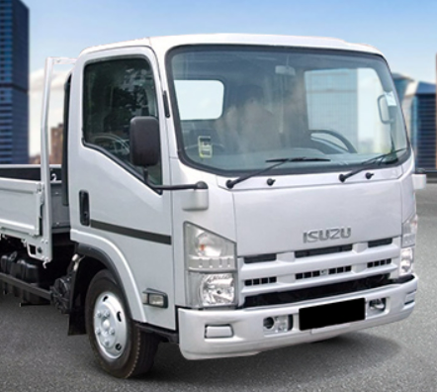
High performance and great aftersales service are opportunities
Target Customer
Draft
Cost Sensitive Preference of JP brand Will to pay for better quality
Offering 1-2 product selections will suffice, avoiding excessive customization. Emphasizing on tax savings, high performance, and better AS compared to regular LD (light-duty)
Main displacement range => 2401cc-3000cc / 3001cc-4200cc Targeting 6-8T with long wheelbase Horsepower: 150hp / Torque: 40
Replacing FUSO(6-9T) / ISUZU(10-18T) to become the third player in the market Each region (north, central, south) should have at least one maintenance facility capable of handling LD (light-duty) vehicles. 10 Direct workshop/ 5 Authorize workshop Leveraging the advantages of collaborative factories or exploring various potential collaborations. According to the past decades data of HINO/FUSO/ISUZU. => We need build the facilities 200 units/facility(per year)
Product Concept
Detail
Strategy and Goal

Slide 27
Summary & Next Step
1. What we have
Light-duty trucks should focus on 8.5T, while medium-duty trucks should target 11/17T as the primary market segments.
The market preference leans towards long-wheelbase, low-displacement, high-performance vehicles.
The light-duty truck market is more sensitive to pricing.
Aftersales service capacity need to keep up with the sales volume.
2. What we need
Clear specifications from the principal regarding the product.
Specific details on maintenance and servicing requirements.
Information on whether the principal has plans for electric vehicles(EV).
3. Next Step
Communicate with potential partners to explore the possibility of providing early-stage service support.
Plan subsequent marketing activities.
Conduct research on location and quantity considerations for establishing new maintenance facilities.
Engage with potential customers to develop customer personas.

